Slide 1


Smart Beach by Bruce County
for Sanjeev Kumar
Sanjeev Kumar - Professor
Brunilda Xhaferllari – Project Manager
Rich Freeman – Faculty Mentor
AI Team:
Janvi Patel
Fangji Chen
Scaria Ouseph Kurian
Date: 29-03-2023
Notes:
Image: 12019 (2016) Ocean waves crashing on shore during daytime https://pixabay.com/photos/beach-sea-sunset-sun-sunlight-1751455/

Slide 2
Architecture updates
V3

Slide 3
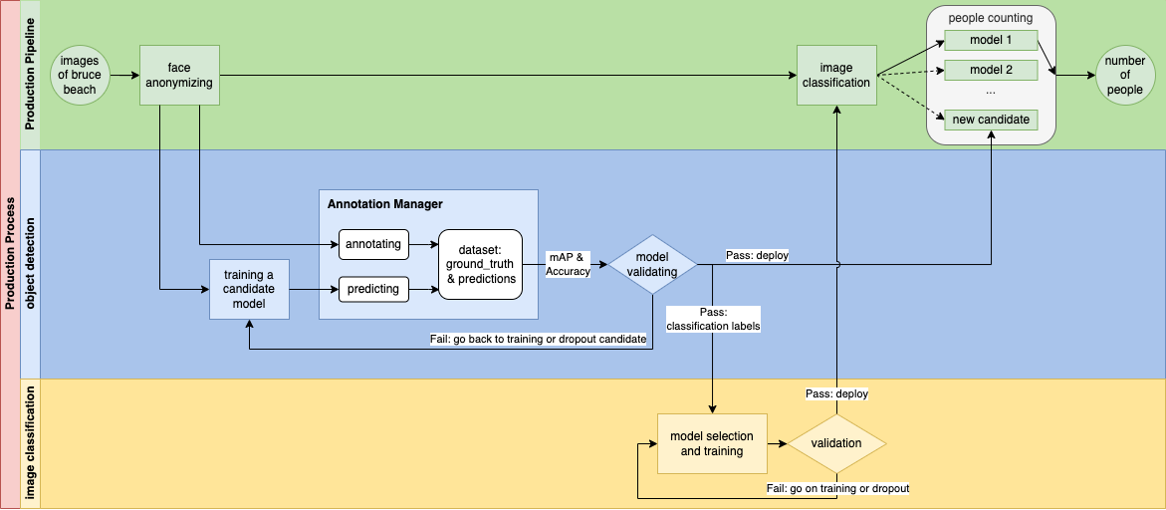

Slide 4
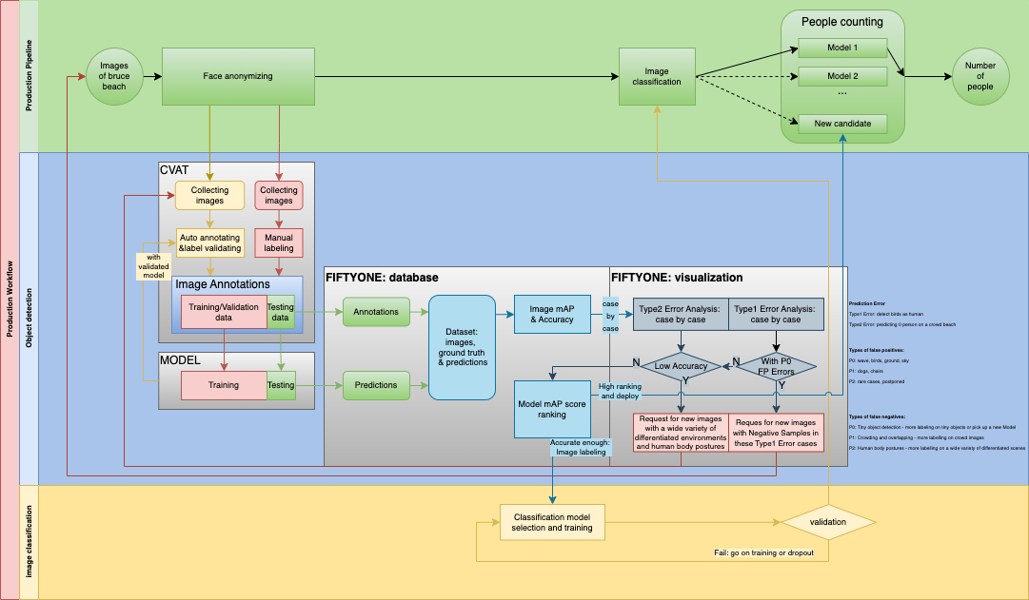

Slide 5
Image Annotating
P0: wave, birds, ground, sky
P1: dogs, chairs
P2: rare cases, will be postponed

Slide 6

Additional activities since the last report
Work:
Annotating all the images of the data provided last week.
Working on documentation of the project.
Training models on new data to get a final accuracy.
Notes:
Padrinan, Miguel (n.d.). Email blocks on Gray Surface. Accessed on January 16th, 2023 from https://www.pexels.com/photo/email-blocks-on-gray-surface-1591062/

Slide 7
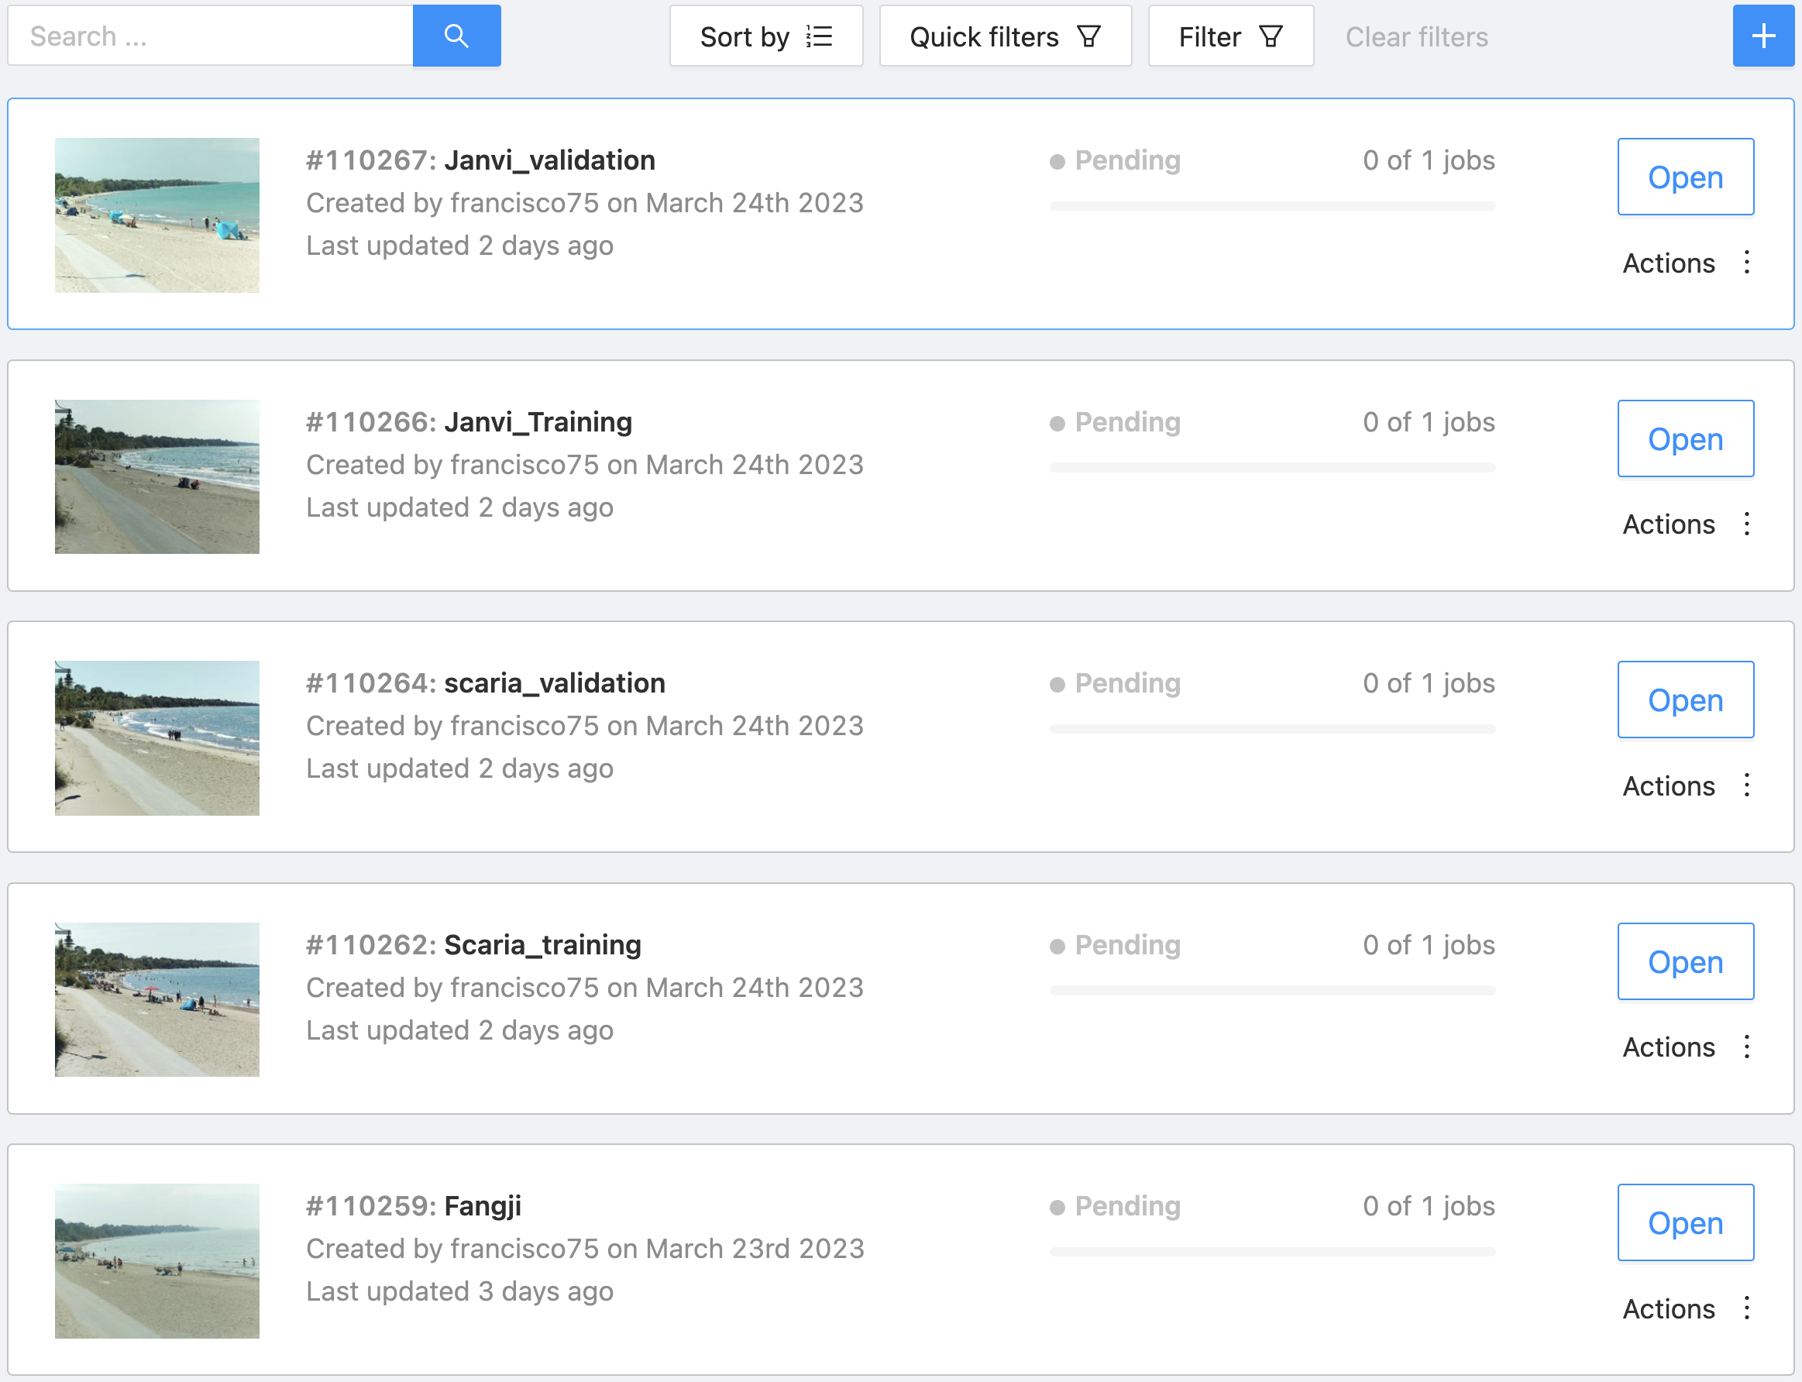
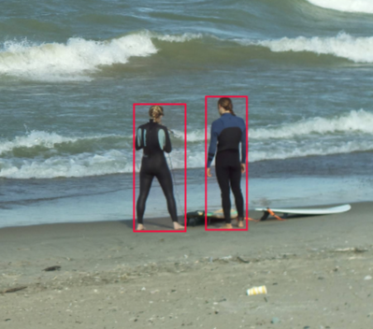
We have divided the tasks into parts to work faster.
As shown above.

Slide 8
Model training

Slide 10
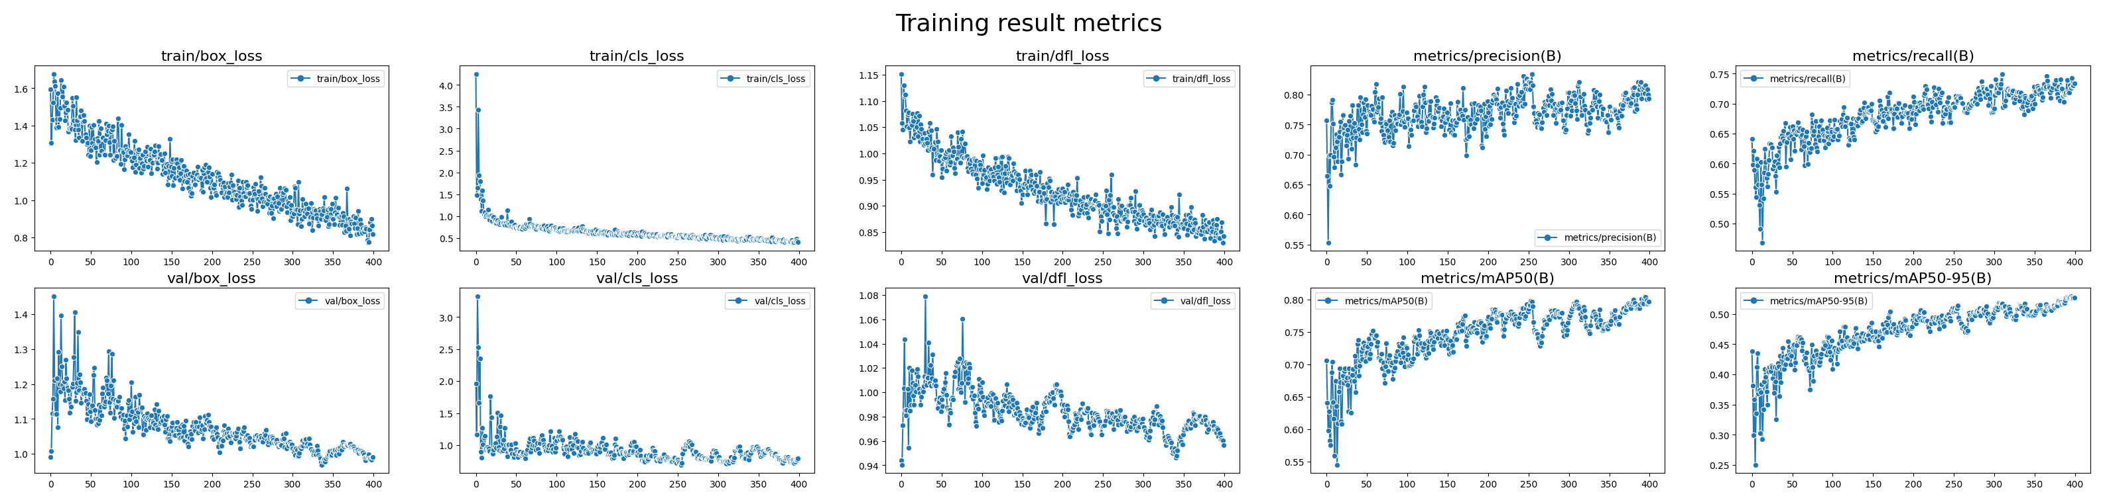
Compared to the previous 35 training images, now with over 25 hours work of annotating, we got a training dataset with 158 images and a validation dataset with 73 images.
Over 12k manual annotated bounding boxes.
The training results are visualized in the image shown above.

Slide 12
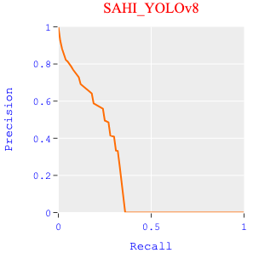
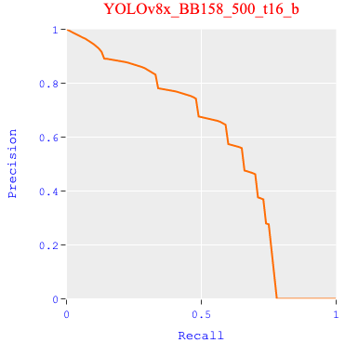
Power of Training
Actually, this special model only has the pieces of knowledge that came from the two cameras.
The training data only includes images in a short period of time: from August to October of 2022.
Any items that the model had never seen will trigger a type 1 error.

Slide 13
Annotations and Prediction errors
What is a bad case?
P0: wave, birds, ground, sky
P1: dogs, chairs, dead-wood bringing by the storm
P2: rare cases, will be postponed

Slide 14
Compare prediction with annotations
on training & validation datasets.
(Actually, we should use the test dataset instead. But we didn’t prepare enough images for that.)

Slide 15
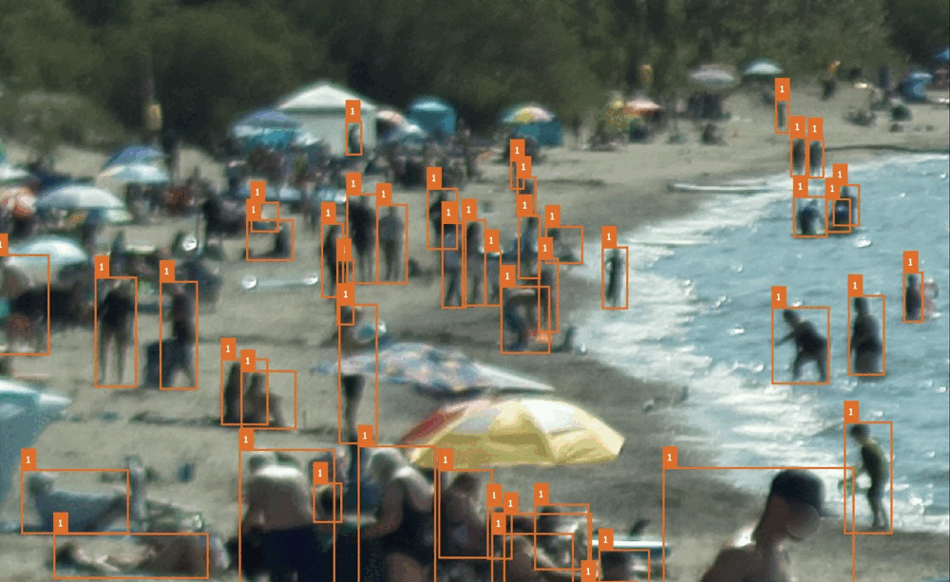
Missed annotations
Bad prediction:
beach umbrella
Bad annotation:
swim ring
Bad prediction:
swim rings

Slide 16
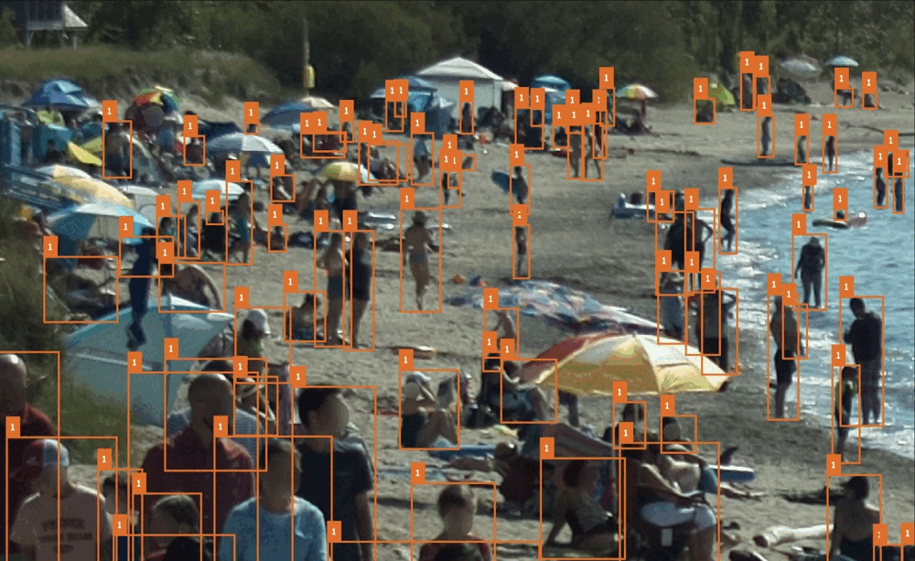
Missed annotations
Bad annotation:
Auto annotating
Bad annotation:
Auto annotating
Bad annotation:
Auto annotating

Slide 17
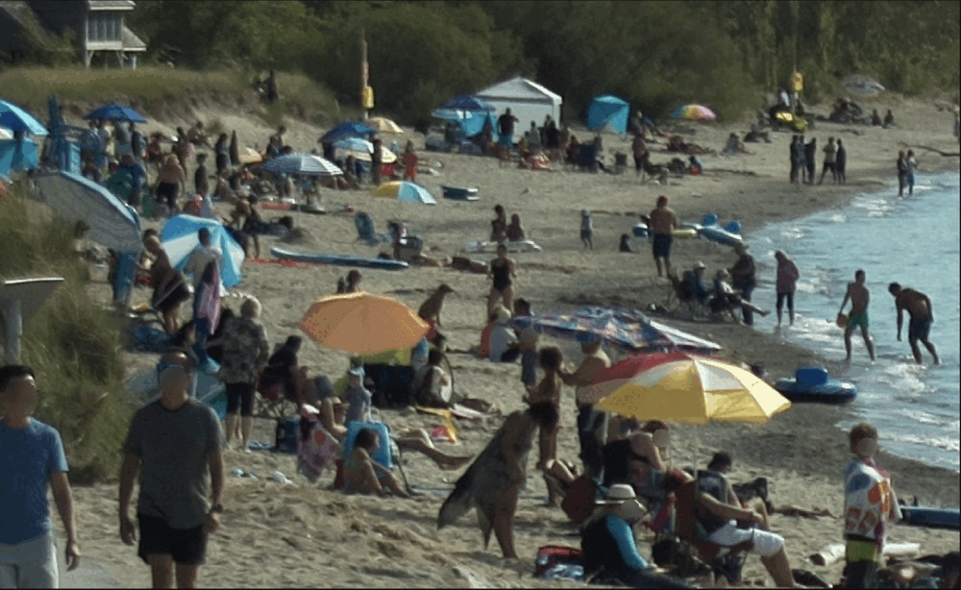
Bad annotation:
Auto annotating
Bad annotation:
dog
Bad annotation:
Crowding
Bad prediction:
Crowding
Bad prediction:
Dog, chair

Slide 18
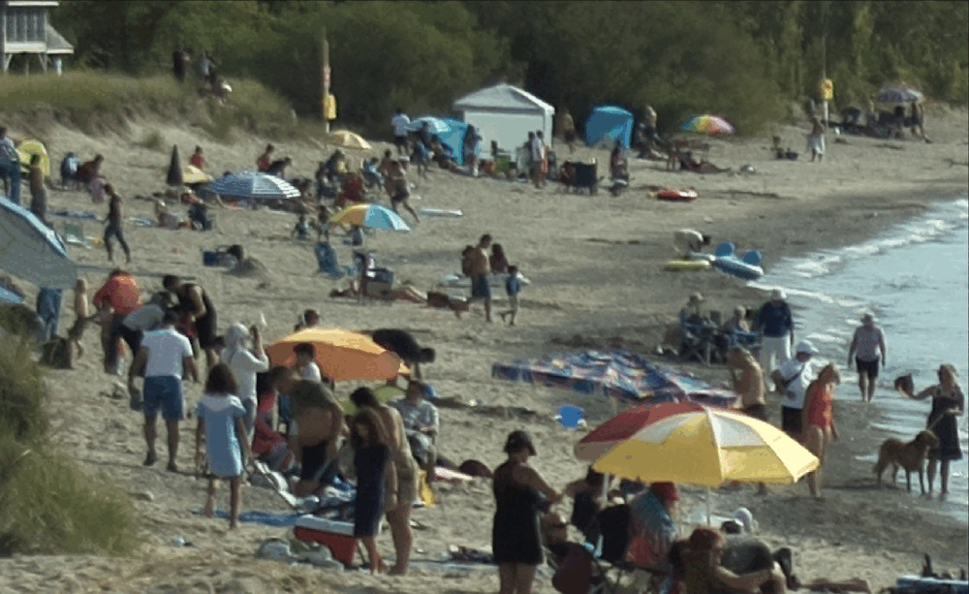
Missing
Bad annotation
Bad annotation
Missing
Bad annotation:
Wrong area of a bounding box
Missing
Bad annotation
Missing

Slide 19
Model validating

Slide 20
Get some clues about which image to see and examine by computing image metrics.

Slide 21
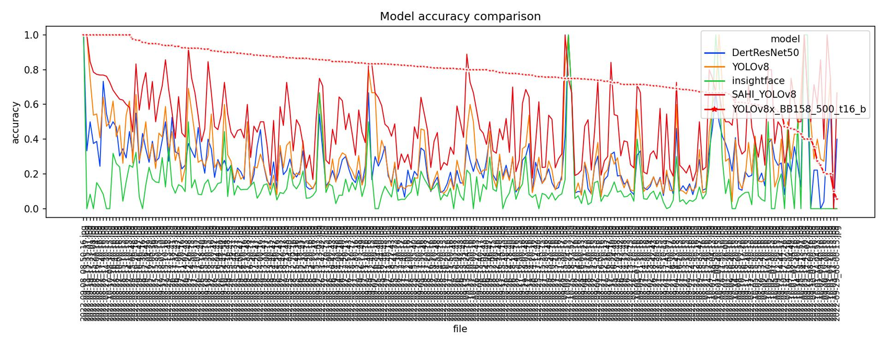
In most of the case, the latest model shows the best accuracy than all the other candidates.
Some bad case are found in this plot due to the reason of the lack of training data: the model needs a wider range of training cases to learn what are the real patterns of people.

Slide 22
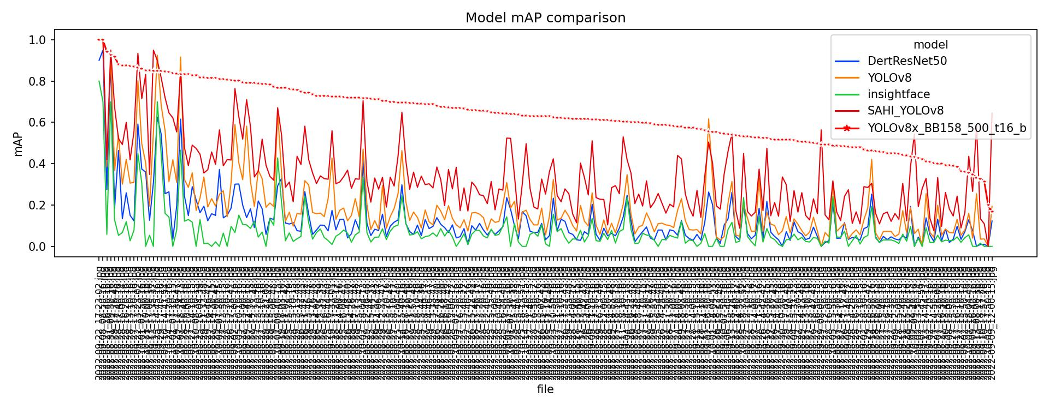
The same issue can be seen in this mAP score metric plot

Slide 23
Annotations and Prediction errors
Keep going

Slide 24
Compare prediction with annotations
on training & validation datasets.
(Actually, we should use the test dataset instead. But we didn’t prepare enough images for that.)

Slide 25
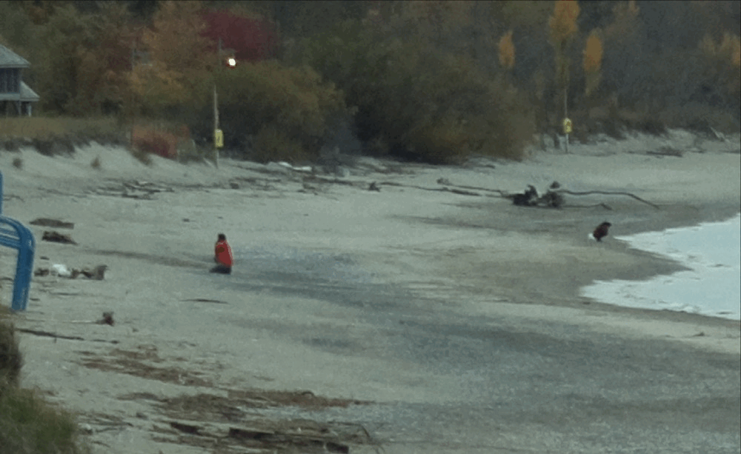
Bad annotation:
Wrong area of a bounding box
Dead-wood
Squatting girl
Dead-wood

Slide 26
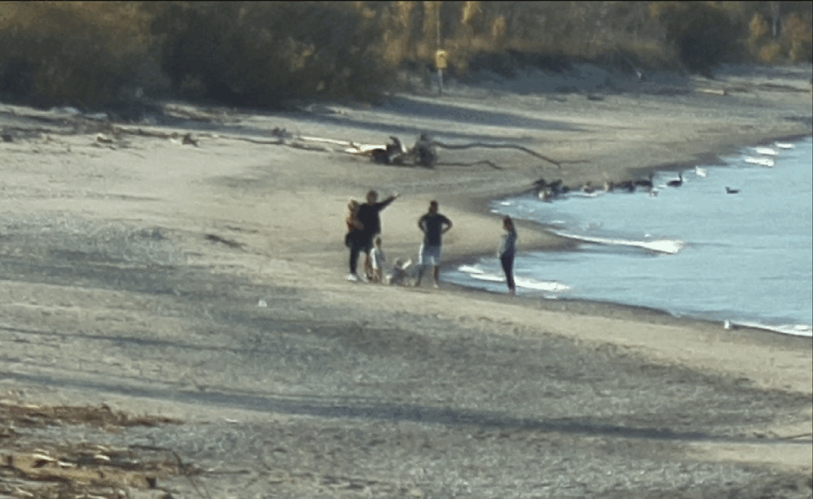
Bad prediction:
recognized a dog as a baby squatting playing sands

Slide 27
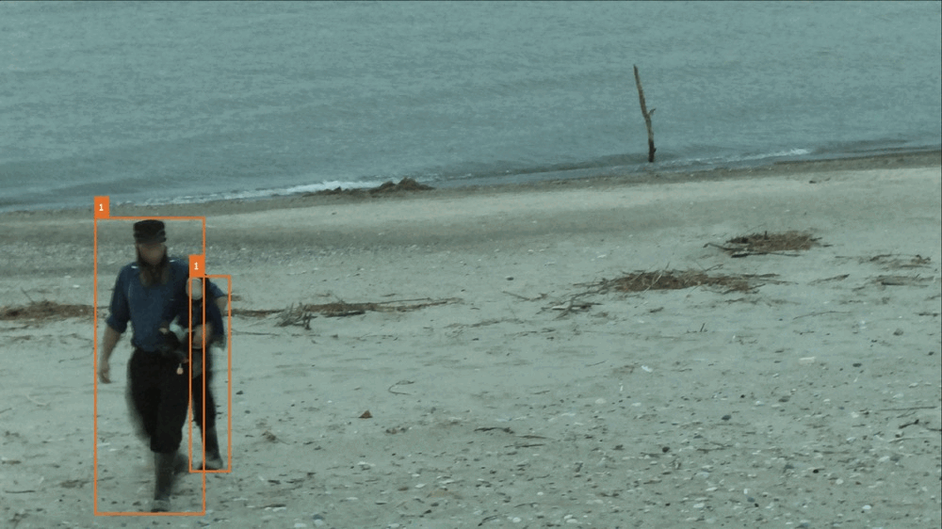
Bad prediction:
Tiny rock

Slide 28
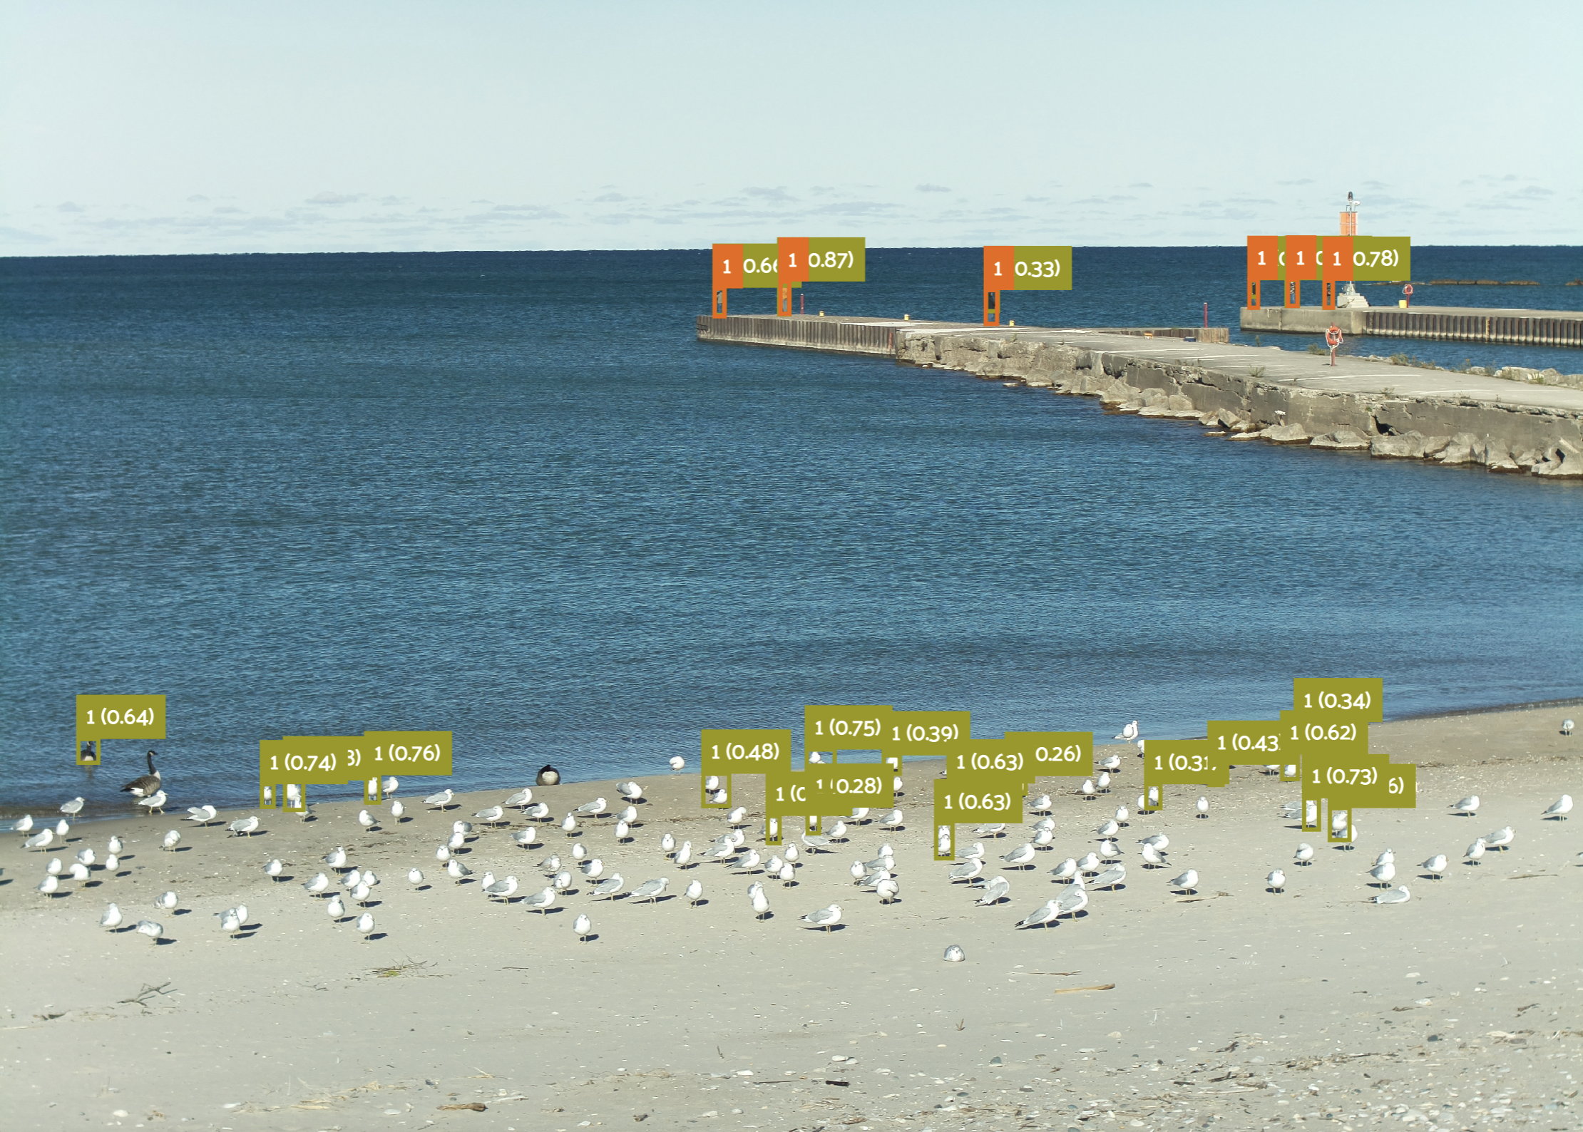
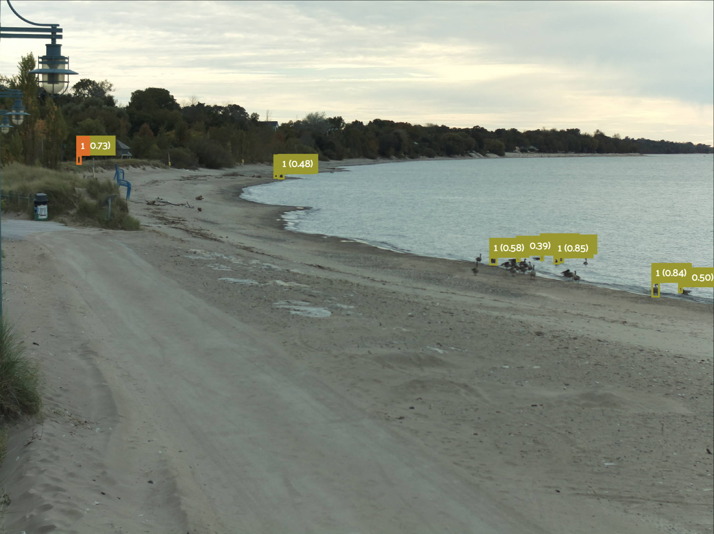
How bad the model performs depends on how empty the shore is...
This is because most of the training data are with crowded people on shore and inshore. A wide range of negative samples is crucial to train a robust model.

Slide 29
Requirements of a robust model
A robust model required a far more diversified and accurate training dataset.
AKA, we need a large-scale image annotation benchmark of Bruce Beach.
More cameras, more images, maybe across several years and tens of thousands of annotated images.

Slide 30
Produce new classification label with a validated model
Even though it‘s not quite ideal, continuing in this direction to enlarge our annotated dataset and training models is the proper thing to do before we finish building a robust benchmark.

Slide 31
Compare prediction with annotations
on training & validation datasets.
(Actually, we should use the test dataset instead. But we didn’t prepare enough images for that.)

Slide 32
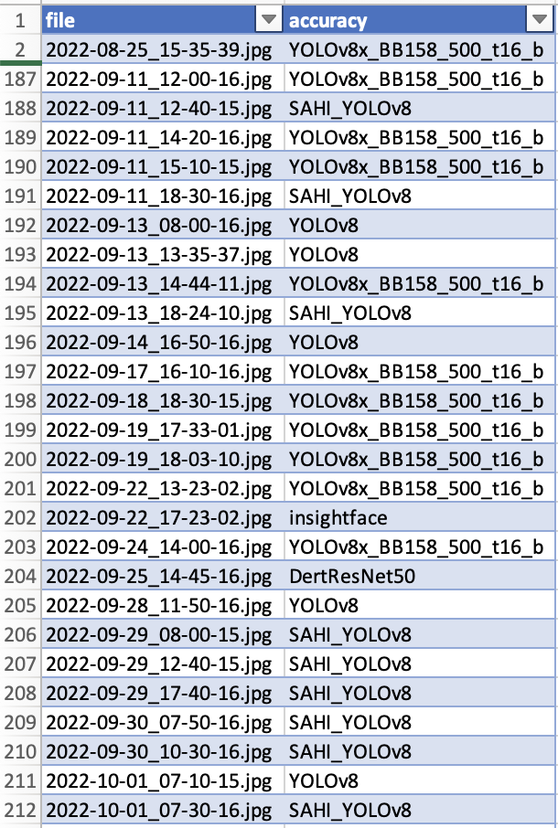
Image classification with labels
The same labels are hidden on the top of this classification ground truth table because the accuracy suggests the same result of YOLOv8x_BB150_500_t16_b.
The new classification model and the people counting model needed to deploy at the same time to match each other.

Slide 33
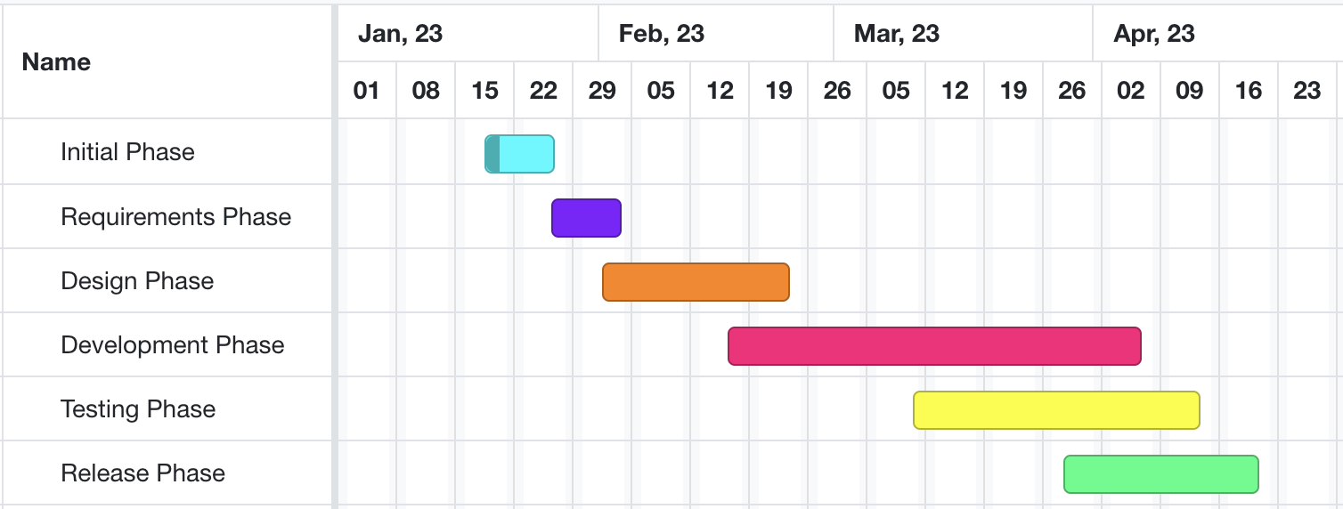
Developing and testing models on beach data
High-level GANTT Chart

Slide 34
Activities to be Completed before Next report:
Final model testing.
Project submission.
Notes:
Olexa, Peter (n.d.) A Person Making a Schedule. Accessed on January 18th, 2023 from https://www.pexels.com/photo/a-person-making-a-schedule-14299948/

Slide 35
Thank you!
Questions?
Notes:
Image: Leloo, The first (2022) https://www.pexels.com/photo/question-marks-on-paper-crafts-5428833/

